Slide 1
Announcements
Project Phase 2 due date is on Sat (April 24 @ 8pm)
https://db.cs.pitt.edu/courses/cs1555/21-2/assign.html
Emails – I’m catching up
Midterm Exams ~30%
A SQL query walks into a bar and sees two tables,
walks up to them and says, 'Can I join you?’
3 SQL databases walked into a NoSQL bar.
A little while later, they walked out because they couldn't find a table.
What is the conclusion?
SQL is always drunk ☺

Slide 2

Database Programming at Large
Stored Procedures and Εmbedded SQL
Notes:
Approaches to database connectivity

Slide 3

Database Management System (DBMS)
Web
Forms
Embedded
SQL
Interactive
SQL
Applications
SQL Commands
DBMS
Query
Evaluation Engine
Concurrency
Control
Files and Access Methods
Recovery
Manager
Buffer Manager
Disk Space Manager
Database
Data
Indexes
Catalog
Notes:
Trace a transaction…

Slide 4
Database Programming
Objective:
To access a database from an application program (as opposed to interactive interfaces)
Why?
An interactive interface is convenient but not sufficient
A majority of database operations are made thru application programs (increasingly thru web applications)
Notes:
AS we have discussed SQL is relational complete but not turing com

Slide 5
Database Programming Approaches
Embedded commands:
Database commands are embedded in a general-purpose programming language
Library of database functions:
Available to the host language for database calls; known as an API (Application Program Interface)
e.g., JDBC, ODBC, PHP, Python
A brand new, full-fledged language
PL/SQL: Procedural Language extensions to SQL
e.g., Postgres PL/pgSQL, Oracle PL/SQL,

Slide 6
Approach 3: SQL/PL
Functions/procedures can be written in SQL itself, or in an external programming language
Functions are very useful with specialized data types
E.g. functions to check if polygons overlap, or to compare images for similarity
Some databases support table-valued functions, which can return a relation as a result
SQL3 also supports a rich set of imperative constructs
Loops, if-then-else, case, assignment + exception handling
Similar to CSH script language
Many DBMS have proprietary procedural extensions to SQL that differ from SQL3.
Notes:
SQL is not turing complete language
SQL is relational complete language

Slide 7
ANSI SQL Functions
authors (author, title, author_order)
Definition of a Function
create or replace function author_count (name varchar(20)) return integer
a_count integer; -- local variable declaration begin select count(author) from authors where authors.title=name; return a_count; end;
/
‘/’: Executes a PL/SQL block
Invocation ?
into a_count -- into is a tuple assignment operator
SELECT title, author_count(title)
FROM books4
WHERE author_count(title)> 1;
Notes:
into is a tuple assignment operator

Slide 8
PL/pgSQL Function
Create a function statement
CREATE [OR REPLACE] FUNCTION func_name(…) RETURNS r_type AS
$$ [ DECLARE declarations ] BEGIN statements END; $$ LANGUAGE plpgsql;
LANGUAGE plpgsql can either appear before the top $$ or after the bottom $$
Drop a function statement
DROP FUNCTION [IF EXISTS] func_name() [CASCADE|RESTRICT];
Notes:
Again, very basic overview, ignoring function arguments, block labels, $$ labels, etc.

Slide 9
PL/pgSQL Example Function
create or replace function author_count (name varchar(20)) returns integer as
$$
declare
a_count integer; -- local variable declaration begin select count(author) into a_count from authors where authors.title=name; return a_count; end;
$$ LANGUAGE plpgsql;

Slide 10
Trigger example in Postgres
CREATE TRIGGER Name_Trim
BEFORE INSERT
ON Student
FOR EACH ROW
WHEN (NEW.Name IS NOT NULL)
EXECUTE FUNCTION trim_spaces_name();
Notes:
FOR EACH STATEMENT is default
trigger fires once per statement that trips it
Note, ignoring constraint triggers, deferrable clauses and from clauses for now
event triggers exist, but we're not going into them at all

Slide 11
PL/pgSQL Trigger Function
CREATE OR REPLACE FUNCTION trim_spaces_name()
RETURNS trigger AS
$$
BEGIN
NEW.name = LTRIM(NEW.name);
RETURN NEW;
END;
$$
LANGUAGE 'plpgsql';

Slide 12
More on triggers in Postgres
CREATE [ CONSTRAINT ] TRIGGER trig_name time event ON table_name
[ NOT DEFERRABLE | [ DEFERRABLE ]
{ INITIALLY IMMEDIATE | INITIALLY DEFERRED } ] [ FOR EACH { ROW | STATEMENT } ] [ WHEN ( condition ) ] EXECUTE {FUNCTION | PROCEDURE} func_name ();
Constraint triggers must be AFTER ROW triggers.
SET CONSTRAINTS trig_name < Evaluation Mode>
Notes:
FOR EACH STATEMENT is default
trigger fires once per statement that trips it
Note, ignoring constraint triggers, deferrable clauses and from clauses for now
event triggers exist, but we're not going into them at all

Slide 13
ANSI SQL Procedures
Definition of a procedure:
create or replace procedure author_count_proc (in title varchar(20), out a_count integer ) begin select count(author) into a_count from authors where authors.title = title; end;
/
Parameters Options: IN, OUT, INOUT
Oracle syntax: (title in varchar(20), a_count out integer )
Notes:
Can merge 6 & 7 partially

Slide 14
PostgreSQL Stored Procedures
CREATE [OR REPLACE] PROCEDURE name(parameters)
LANGUAGE language_name
AS $$
stored_procedure_body;
$$;
Parameters Options: IN, INOUT, or VARIADIC
If omitted, the default is IN
There is no OUT
VARIADIC is array parameter
language_name: SQL or PLpgSQL (or plpgsql)
If you want to end a procedure earlier, you can use the RETURN statement with no expression as follows: RETURN;

Slide 15
Stored Procedure (Parameters by position)
CREATE OR REPLACE PROCEDURE transfer_proc (INT, INT, DEC)
LANGUAGE plpgsql
AS $$
BEGIN
-- subtracting the amount from the sender's account
UPDATE accounts
SET balance = balance - $3
WHERE id = $1;
-- adding the amount to the receiver's account
UPDATE accounts
SET balance = balance + $3
WHERE id = $2;
END; -- or COMMIT;
$$;

Slide 16
ANSI/PGSQL Procedures: Invocation
Procedures can be invoked either within a trigger, an SQL procedure, or from embedded SQL, using the
Call statement.
E.g., from an SQL procedure block
declare a_count integer;
begin
call author_count_proc (‘Database Systems’, a_count);
call transfer (101, 102, 300.50);
end;
SQL3 allows name overloading for function and procedures, as long as the number or types of arguments is different.

Slide 17
PostgreSQL PL/pgSQL
Based on ADA
Assignments: direct (:=) and retrieval (INTO)
Conditional Statements:
Oracle PL/SQL: Same but with { }
IF <condition>
THEN
<statement;>
ELSIF <condtion> THEN
<statement;>
ELSE
<statement;>
END IF;
IF <condition>
THEN
<statement;>
ELSE
<statement;>
END IF;

Slide 18
PostgreSQL PL/pgSQL
Oracle PL/SQL: Same but with { }
Iterative Statements
Simple Loop
LOOP
<statement;>
EXIT; [or EXIT WHEN condition;]
END LOOP;
While Loop
WHILE <condition> LOOP <statement;> END LOOP;
For Loop
FOR counter IN [REVERSE] val1..val2 LOOP
<statement;
END LOOP;

Slide 19
ANSI Exceptions
Signaling of exception conditions, and declaring handlers for exceptions
declare out_of_stock condition declare exit handler for out_of_stock begin … .. signal out_of_stock end;
The handler here is exit -- causes enclosing begin..end to be exited
Other actions possible on exception

Slide 20
Exception handling in PL/pgSQL
EXCEPTION clause at the end of a block:
BEGIN statements; … EXCEPTION WHEN condition [ OR condition … ] THEN handler_statements; [ WHEN condition [ OR condition … ] THEN handler_statements;] … [ WHEN OTHERS THEN
handler_statements;] END;
PostgreSQL Error Codes: https://www.postgresql.org/docs/12/errcodes-appendix.html
Notes:
pgSQL error codes linked on website

Slide 21
PL/pgSQL: Block Structure
Student(SID,Name,Major,QPA)
DO $$ -- anonymous function
Declare -- optional
x integer := 0;
y student.sid%type;
Begin -- mandatory
select count(*) into x
from Student
where Major = 'CS';
if x < 1 then RAISE 'bad_data' using errcode='MYERR’;
else RAISE notice 'Number of CS Majors =%',x;
end if;
Exception -- optional
when sqlstate 'MYERR' then
RAISE notice 'troubles’;
End $$;
-- RAISE: report messages and raise errors
-- User defined error code
-- (5 characters)
Notes:
Based on ADA

Slide 22
PL/SQL: Var & Const
DECLARE: introduces variables, constrants & records
Variables & Constants
<variable_name> datatype [NOT NULL := value ];
<constant_name> CONSTANT datatype := VALUE;
Declaration of variables/constants based on a column from database table
<variable_name> table_name.column_name%type;
E.g., y student.SID%type;

Slide 23
PL/SQL: Records
Record type
TYPE <record_type_name> IS RECORD (<1st_col_name> datatype,
<2nd_col_name> datatype, ...);
Declare fields based on a column from database table
col_name table_name.column_name%type;
Record variable declaration
User-defined: record_name record_type_name;
DB-based: record_name table_name%ROWTYPE;
E.g., student_rec Student%rowtype;
Notes:
Direct assignment := and retrieval assignment INTO

Slide 24
PL/pgSQL: “Record”
rec_name RECORD;
Has no predefined structure
Substructure is set when it is assigned a value

Slide 25
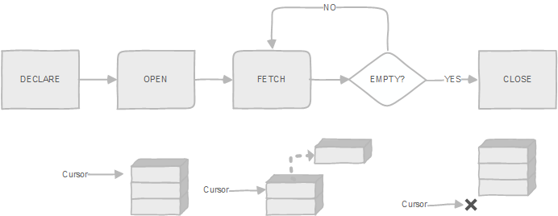
Cursors: Multiple Tuple Retrieval
If more than one tuples can be selected, then tuples must be processed one at a time by means of a cursor
This is similar to the record-at-a-time processing
A cursor is a "pointer" to a tuple in a result of a query
Current tuple w.r.t. a cursor is the tuple pointed by the cursor
App
Runtime Env
Source: http://www.postgresqltutorial.com/plpgsql-cursor/

Slide 26
PL/pgSQL Cursors
<cursor_name> CURSOR {IS | FOR} <query>
It declares a cursor by defining a query to be associated with a cursor with it
E.g., curs1 CURSOR FOR SELECT * FROM table1; curs2 CURSOR (key integer) IS SELECT * FROM table1 WHERE att1 = key;
OPEN <cursor_name> brings the query result from the DB and positions the cursor before the first tuple
Before a cursor can be used, it must be opened
OPEN curs1;
OPEN curs2(42);
OPEN curs2(key:=42);
CLOSE <cursor_name> closes the named cursor and deletes the associated result table

Slide 27
PL/pgSQL Cursors
Fetch copies into variables the current tuple and advances the cursor
FETCH [direction { FROM | IN }] cursor INTO target;
target should be a RECORD (ROWTYPE) or list of variables
direction can take on many forms, e.g.:
FETCH curs1 INTO student_rec;
FETCH curs2 INTO SID, Name, Major, QPA;
FETCH LAST FROM curs3 INTO x, y;
FETCH RELATIVE -2 FROM curs4 INTO recvar;
Special variable FOUND will be set to true if a row is returned from the fetch
Move repositions a cursor without retrieving any data
MOVE [ direction { FROM | IN } ] cursor;

Slide 28
Cursor example in Postgress
CREATE FUNCTION qpa_avg() RETURNS DECIMAL AS $$
DECLARE
qpa_sum DECIMAL := 0; st_count INTEGER := 0;
st_cursor CURSOR FOR SELECT SID, Name, Major, QPA
FROM Student;
student_rec Student%ROWTYPE;
BEGIN
OPEN st_cursor;
LOOP
FETCH st_cursor INTO student_rec;
IF NOT FOUND THEN
EXIT;
END IF;
qpa_sum := qpa_sum + student_rec.QPA;
st_count := st_count + 1;
END LOOP;
CLOSE st_cursor; RETURN qpa_sum / st_count;
END; $$ LANGUAGE plpgsql;
select qpa_avg();
Student(SID,Name,Major,QPA)
Notes:
Note there are wildly simpler ways to implement this
FOR loops over cursors
FOR loops over queries, skipping cursors
TEST!!

Slide 29
Implicit Cursor in Postgress
CREATE OR REPLACE PROCEDURE proc_retrieve_reservations()
LANGUAGE plpgsql
AS
$$
DECLARE
reservation_record RECORD;
BEGIN
-- Loop across all reservation numbers & prints them out
FOR reservation_record IN SELECT * FROM Reservation
LOOP
raise notice '%',reservation_record.Reservation_Number;
END LOOP;
END
$$;

Slide 30


External Language Functions/Procedures
Declaring external language procedures and functions
In C/C++
create procedure author_count_proc (in title varchar(20),
out count integer) language C external name’ /usr/db/bin/author_count_proc’
In Java
create function author_count ( title varchar(20) ) returns integer language Java
external name ‘/usr/db/bin/author_count.jar’

Slide 31
Example in PostgreSQL for C/C++
Supposing that the increment function was implemented in file funcs.c and compiled into a shared object
cc -fPIC -c funcs.c
cc -shared -o funcs.so funcs.o
The increment function is introduced to PostgreSQL:
CREATE FUNCTION add_one(integer) RETURNS integer
AS 'DIRECTORY/funcs', 'add_one’
LANGUAGE C STRICT;
Then it can be called as usual:
SELECT name, add_one(age) AS new_age
FROM emp
WHERE name = 'Bill' OR name = 'Sam';

Slide 32

External Routines: Performance Vs. Security
Benefits of external language functions/procedures:
more efficient for many operations, and
more expressive power
Drawbacks
Code to implement function may need to be executed in the database system’s address space
risk of accidental corruption of database structures
security risk, allowing users access to unauthorized data
Use sandbox techniques
that is use a safe language like Java
Direct execution in the database system’s space is used when efficiency is more important than security

Slide 33
Disadvantages of stored procedures
Slowness in software development because stored procedure programming requires specialized skills that many developers do not possess.
Difficult to manage versions and hard to debug.
May not be portable to other database management systems e.g., MySQL or Microsoft SQL Server.
Notes:
All SQL statements are wrapped inside a function stored in the PostgreSQL database server so the application only has to issue a function call to get the result back instead of sending multiple SQL statements and wait for the result between each call

Slide 34
Database Programming Approaches
Embedded commands:
Database commands are embedded in a general-purpose programming language
Library of database functions:
Available to the host language for database calls; known as an API (Application Program Interface)
e.g., JDBC, ODBC, PHP, Python
A brand new, full-fledged language
e.g., Oracle PL/SQL, Postgres PL/pgSQL
Procedural Language extensions to SQL
Notes:
Stopped HERE – Section #1

Slide 35
Embedded SQL (ESQL)
SQL statements are embedded by enclosing them:
between “&SQL(“ and “)”;
between "EXEC SQL” and "END-EXEC"; or
between "EXEC SQL" and ";“
E.g., EXEC SQL DELETE FROM STUDENT WHERE Name LIKE ‘John %';
Two types of statement-level embedding:
Static SQL: complete SQL statements
Dynamic SQL: statements are created during execution time

Slide 36
Structure of ESQL Programs
Define host data structures
Open database using EXEC SQL CONNECT dbname/username IDENTIFIED BY password
Start a transaction using EXEC SQL SET TRANSACTION command
Retrieve data using EXEC SQL SELECT and load into data structure that overlays row
Write data back to the database using EXEC SQL UPDATE, or INSERT, or DELETE
Terminate the transaction using either EXEC SQL COMMIT or EXEC SQL ROLLBACK
Close database using EXEC SQL DISCONNECT

Slide 37
Host Data Structure
Program variables used within an SQL command are declared within a DECLARE SECTION
E.g.,
EXEC SQL BEGIN DECLARE SECTION
char student_name[20];
EXEC SQL END DECLARE SECTION
Host structures/records (e.g., C struct) must match tuple formats exactly
field order is important
strings in C/C++ are terminated with NULL character
e.g., if Student.Major char(4), then char major[5] in C/C++

Slide 38
Scope Rules
The arguments used in an SQL statement could be constants or program variables
Program variables within an SQL command are prefixed with “:”
E.g.,
EXEC SQL BEGIN DECLARE SECTION
char student_name[20];
EXEC SQL END DECLARE SECTION
cout << "Please Enter Student Name to be deleted" << endl;
cin >> (char *) student_name;
EXEC SQL DELETE FROM STUDENT
WHERE Name = : student_name;

Slide 39
Status of an SQL Cmd Execution
SQLCODE in SQL1 is an integer variable containing the Status Code returned by SQL/DBS
Zero (0) if SQL command is successful
Nonzero positive if SQL generates a warning
100: data not found
Negative if SQL command fails (error)
-913: resource deadlock
SQLSTATE in SQL2 is a 5-character string
02000: data not found

Slide 40
NULL Values & Indicators
INDICATORS are used to hold the status of variables and test for NULL values.
An indicator is associated with each variable:
Short integer (2 bytes).
-1 : indicates NULL value
0 : indicates valid data value.
Always check indicator when reading.
Always set indicator when writing.
Note that each field in a struct is a separate variable. That is, a 4 field struct is associated with 4 indicators
Indicators could be a struct or an array depending on the implementation

Slide 41
Host Data for Single Retrieval
Student(SID,Name,Major)
Struct {
int sid;
VARCHAR student_name[UNAME_LEN];
char major[5];
} student_rec;
Struct {
short sid_ind;
short student_name_ind;
short major_ind;
} student_rec_ind;

Slide 42
Embedded SQL Single Retrieval
printf("\nEnter Student number (0 to quit): ");
gets(temp_char);
student_number = atoi(temp_char);
EXEC SQL WHENEVER NOT FOUND GOTO notfound;
EXEC SQL SELECT SID, Name, Major
INTO :student_rec INDICATOR :student_rec_ind
FROM STUDENT
WHERE SID = :student_number;
display_student(student_rec, student_rec_ind);
notfound display_error();

Slide 43
ESQL Cursors
If more than one tuples can be selected, then tuples must be processed one at a time by means of a cursor
This is similar to the record-at-a-time processing
A cursor is a "pointer" to a tuple in a result of a query
Current tuple w.r.t. a cursor is the tuple pointed by the cursor
DECLARE <cursor-name> CURSOR FOR <query>
It defines a query and associates a cursor with it
OPEN <cursor-name> brings the query result from the DB and positions the cursor before the first tuple
CLOSE cursor-name closes the named cursor and deletes the associated result table

Slide 44
Cursor Retrieval
Sequential Access:
FETCH <cursor-name> INTO <variable-list>;
copies into variables the current tuple and advances the cursor
Use SQLCODE, SQLSTATE, or WHENEVER NOT FOUND to detect end of result table
Random Access: (positioning of cursor)
FETCH orientation
FROM <cursor-name> INTO <variable-list>;
where orientation: NEXT (default), PRIOR, LAST,
ABSOLUTE <offset>, RELATIVE <offset>

Slide 45
Cursor Retrieval Example
EXEC SQL DECLARE st_cursor CURSOR FOR
SELECT SID, Name, Major
FROM STUDENT
WHERE Major = ‘CS’;
EXEC SQL OPEN st_cursor;
While (1) {
EXEC SQL WHENEVER NOT FOUND DO break;
EXEC SQL FETCH st_cursor
INTO :student_rec INDICATOR :student_rec_ind;
display_student(student_rec, student_rec_ind);
};
EXEC SQL CLOSE st_cursor;

Slide 46
Dynamic SQL Statements
An SQL statement is passed to DBMS in the form of a string to be interpreted and executed
EXECUTE IMMEDIATE
PREPARE, EXECUTE, USING
create/drop table
insert, delete, update
Dynamic DECLARE CURSOR, DESCRIBE, OPEN, FETCH
select statement
RELEASE

Slide 47
Dynamic SQL: Prepare-Execute-Using
It compiles an SQL statement with parameters indicated with "?"
char sqltxt[] = "DELETE FROM STUDENT WHERE id = ? AND name = ?”;
EXEC SQL PREPARE delcmd FROM : sqltxt;
USING statement allows the passing of parameters
cout << "Please Enter Student ID & Name to be deleted" << endl;
cin >> (char *) string_id; cin >> (char *) student_name;
student_id=atoi(string_id);
EXEC SQL EXECUTE delcmd USING : student_id, : student_name;
Release statement
EXEC SQL RELEASE delcmd;

Slide 48
SQLJ: SQL-Java
Semi-static version of embedded SQL in Java
SQL statements are introduced with: #sql
#sql { delete from STUDENT where SID = :stid };
#sql { insert into STUDENT (SID) values (165) };
Iterator object supports the notion of cursor
#sql iterator ST_Cursor (Integer Sid, String Name);
ST_Cursor stCursor;
#sql stCursor = { SELECT SID, Name INTO :Sid, :Name
FROM STUDENT WHERE Major = ‘none’};
while (stCursor.next()) {
System.out.println(stCursor.Sid() + ”, “ + stCursor.Name()); }
stCursor.close();

Slide 49
SQLJ: Simple yet complete example
import java.sql.*; // you need this import for SQLException and other classes from JDBC
import oracle.sqlj.runtime.Oracle;
public class SingleRowQuery extends Base {
public static void main(String[] args) {
try { connect();
singleRowQuery(1);
} catch (SQLException e) { e.printStackTrace(); }
}
public static void singleRowQuery(int id) throws SQLException {
String fullname = null;
String street = nul
#sql {
SELECT fullname,
street INTO : OUT fullname, //OUT is actually the default for INTO host variables
: OUT street FROM customer WHERE ID = :id};
System.out.println("Customer with ID = " + id);
System.out.println(); System.out.println(fullname + " " + street);
}
}

Slide 50
Database Programming Approaches
Embedded commands:
Database commands are embedded in a general-purpose programming language
Library of database functions:
Available to the host language for database calls; known as an API (Application Program Interface)
e.g., JDBC, ODBC, PHP, Python
A brand new, full-fledged language
e.g., Oracle PL/SQL
Procedural Language extensions to SQL

Slide 51
JDBC: An example of SQL API
JDBC resembles dynamic SQL, in which SQL statements are passed in the form of strings
JDBC supports its own dialect of SQL
An application program (Java applet) executes an SQL statement by submitting it to the JDBC driver manager
Any database using can be accessed as long as an appropriate DBMS-specific driver exists, is loaded, and is registered with the driver manager:
import java.sql.*;
Class.forName("jdbc.driver_name");

Slide 52
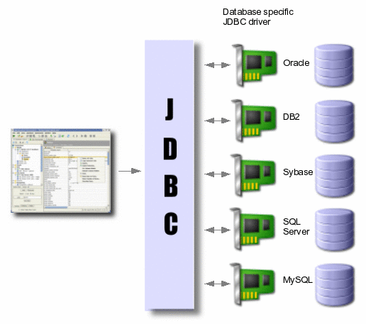
JDBC Configuration

Slide 53
JDBC Drivers

Slide 54
JDBC Drivers
Type 1: JDBC-ODBC bridge. This driver translates JDBC calls into ODBC calls.
Type 2: Java JDBC Native Code. This partial Java driver converts JDBC calls into client API for the DBMS.
Type 3: JDBC-Gateway. This pure Java driver connects to a database middleware server that in turn interconnects multiple databases and performs any necessary translations.
Type 4: Pure Java JDBC. This driver connects directly to the DBMS.

Slide 55
Useful Links
JDBC DRIVER
https://jdbc.postgresql.org/download.html
JDBC API
https://docs.oracle.com/javase/8/docs/technotes/guides/jdbc/

Slide 56
Accessing a Database
Open Connection:
Connection dbcon;
dbcon= DriverManager.getConnection(<“URL”>,<"userId”>,<”pwd”>);
E.g.,
import java.sql.*;
public class JavaDemo {
private Connection dbcon; private String username = “PittID”, password = “PSNum”;
public JavaDemo() {
Class.forName("org.postgresql.Driver");
String url = "jdbc:postgresql://class3.cs.pitt.edu:5432/dbclass";
dbcon = DriverManager.getConnection(url, username, password);
…
Close connection: dbcon.close();

Slide 57
Executing an SQL Statement
Statement class: Execute SQL statements without parameters
Create statement object
Statement st;
st = dbcon.createStatement();
Directly execute: Select, Update, Insert, Delete, DDL
st.executeQuery(<“sql-query”>);
st.executeUpdate(<“sql-modification”>);
Example of an SQL modification
int numberrows = st.executeUpdate ("INSERT INTO STUDENT VALUES (123, ‘J.J. Kay', ‘CS’)");
Table can be prefixed by its schema, e.g., cs1555.STUDENT

Slide 58
Querying a database & Cursors
String fname = readString("Enter First Name: ");
String query1 = "SELECT SID, Name, Major FROM STUDENT
WHERE Name LIKE ‘ " + fname + “ ‘“ ;
ResultSet res1 = st.executeQuery(query1);
int rsid; String rname, rmajor;
while (res1.next()) {
rsid = res1.getInt(“SID”);
rname = res1.getString(“Name”);
rmajor = res1.getString(3);
System.out.print(rsid+” “+rname+" "+rmajor);
};
getXXX(param)
XXX: valid SQL Type
param: name or index
wasNull() returns True if the last getXXX() value should be read as NULL
if (res1.wasNull()) {
System.out.print(rsid+” “+rname+" NULL”); }
else { System.out.print(rsid+” “+rname+" "+rmajor); }
};
Notes:
Lecture slide

Slide 59
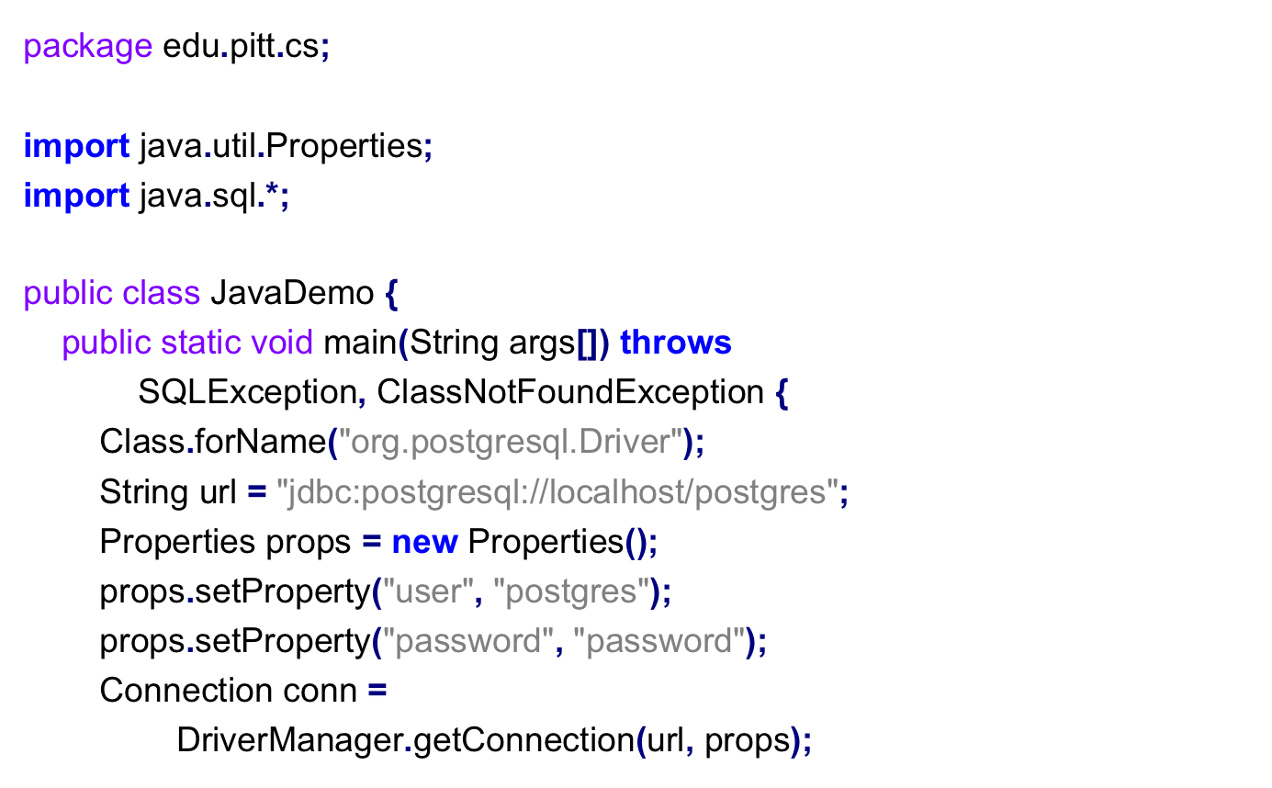
JDBC Example in PostgreSQL

Slide 60
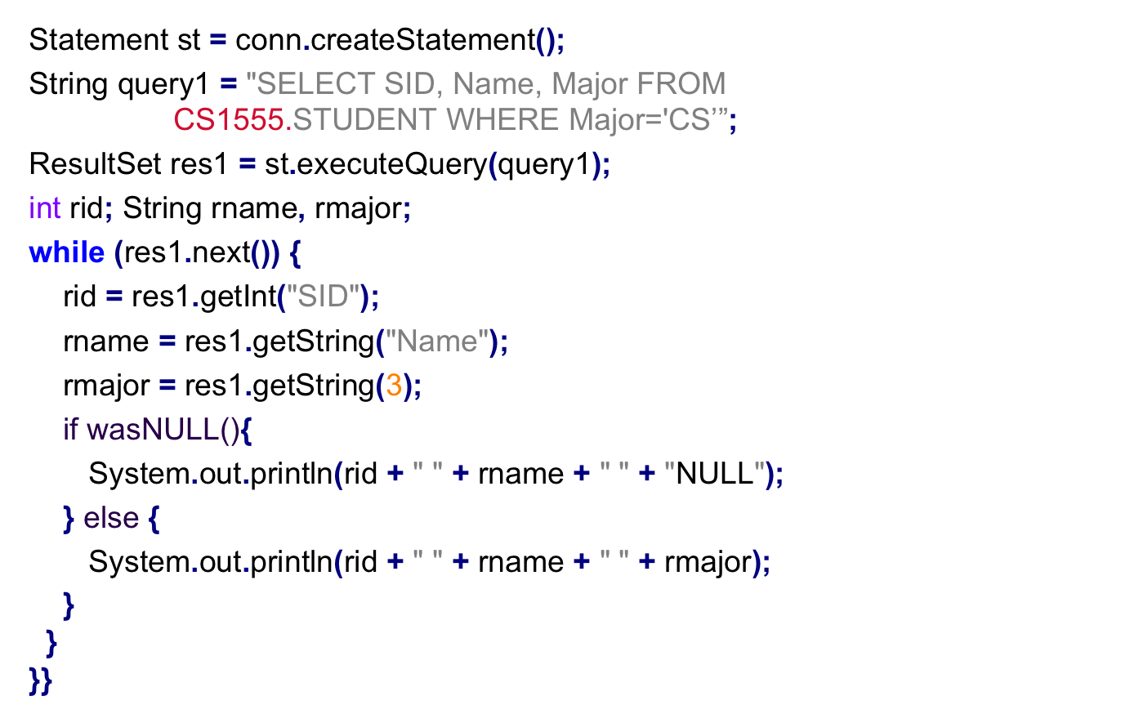
JDBC Example in PostgreSQL
If (res1.wasNull()) {

Slide 61
Cursor Navigation Types
Statement stC = dbcon.createStatement ( [{ResultSet.NAV_TYPE}], [ResultSet.CONCUR_TYPE] );
NAV_TYPE
TYPE_FORWARD_ONLY: ResultSet can only be navigated forward.
SCROLL_INSENSITIVE: ResultSet can be navigated forward, backwards and jump. Concurrent db changes are not visible.
SCROLL_SENSITIVE: ResultSet can be navigated forward, backwards and jump. Concurrent db changes are visible.

Slide 62
Cursor Concurrency Types
Statement stC = dbcon.createStatement ( [{ResultSet.NAV_TYPE}], [ResultSet.CONCUR_TYPE] );
CONC_TYPE
CONCUR_READ_ONLY: ResultSet can only be read
CONCUR_UPDATABLE: ResultSet can be updated

Slide 63
Moving Cursors
Statement stC = dbcon.createStatemen (ResultSet.TYPE_SCROLL_INSENSITIVE, ResultSet.CONCUR_READ_ONLY);
ResultSet resultSet = stC.executeQuery("SELECT * FROM STUDENT");
int pos = resultSet.getRow(); // Get cursor position, pos = 0
boolean b = resultSet.isBeforeFirst(); // true
resultSet.next(); // Move cursor to the first row
pos = resultSet.getRow(); // Get cursor position, pos = 1
b = resultSet.isFirst(); // true
resultSet.last(); // Move cursor to the last row
pos = resultSet.getRow(); // If table has 10 rows, pos = 10
b = resultSet.isLast(); // true
resultSet.afterLast(); // Move cursor past last row
pos = resultSet.getRow(); // If table has 10 rows, value would be 11
b = resultSet.isAfterLast(); // true

Slide 64
The PreparedStatement Class
Create and pre-compile parameterized queries using parameters markers, indicated by question marks (?)
PreparedStatement st2 = dbcon.prepareStatement
( "SELECT * FROM STUDENT WHERE Name LIKE ?");
Specify the values of parameters using setXXX(i,v) where XXX: SQL type in including NULL,
i: argument-index,
v: value
String fname = readString("Enter First Name: ");
st2.setString(1, fname);
ResultSet res2 = st2.executeQuery();

Slide 65
Error Handling
JDBC provides the SQLException class to deal with errors
try { ResultSet res3 =
st.executeQuery("SELECT * FROM STUDENT"); }
catch (SQLException e1) {
System.out.println("SQL Error");
while (e1 != null) {
System.out.println("Message = "+ e1.getMessage());
System.out.println("SQLState = "+ e1.getSQLstate());
System.out.println("SQLState = "+ e1.getErrorCode());
e1 = e1.getNextException();
}; };
Notes:
toString() -- The name of the actual class of this object || ": " (a colon and a space) || The result of the getMessage() method for this object
getSQLState() -- Retrieves the SQLState for this SQLException object.
getErrorCode() -- Retrieves the vendor-specific exception code for this SQLException object.

Slide 66
Error Handling
JDBC provides the SQLException class to deal with errors
try { ResultSet res3 =
st.executeQuery("SELECT * FROM STUDENT"); }
catch (SQLException e1) {
System.out.println("SQL Error");
while (e1 != null) {
System.out.println("Message = "+ e1.getMessage());
System.out.println("SQLState = "+ e1.getSQLstate());
System.out.println("SQLState = "+ e1.getErrorCode());
e1 = e1.getNextException();
}; };
System.out.println("Message = "+ e1.toString());
Notes:
toString() -- The name of the actual class of this object || ": " (a colon and a space) || The result of the getMessage() method for this object
getSQLState() -- Retrieves the SQLState for this SQLException object.
getErrorCode() -- Retrieves the vendor-specific exception code for this SQLException object.

Slide 67
Executing Transactions
Each JDBC statement is treated as a separate transaction that is autocommitted by default
dbcon.setAutoCommit(false);
A new transaction automatically is set after either
dbcon.commit(); or dbcon.rollback();
Set Constraint Mode
ResultSet res1 = st.executeQuery(“SET CONSTRAINTS ALL DEFERRED”);
Five transaction isolation levels (to be discussed later)
setTransactionIsolation(int level);
No global transactions, transactions across many db
No atomicity or “all or nothing property”
Notes:
setReadOnly(boolean readOnly) ;

Slide 68
Not Deferred Constraints
Transaction atomicity is enforced in a flexible way by the developer (with the support of the DBMS), e.g.:
try {
dbcon.setAutoCommit(false); st.executeUpdate("insert into student values (23, 'John', 'CS')"); st.executeUpdate("insert into Dept values (15, 'Joanne', 'CoE')"); dbcon.commit(); } catch (SQLException e1) { try {
dbcon.rollback();
} catch(SQLException e2) { System.out.println(e2.toString()); }
}

Slide 69
JDBC: Stored Functions
SQL:
SELECT upper('database'); -- Invocation in DataGrip
“select” for functions only (default)
“callIfNoReturn” for procedures and functions
“call” for procedures only
JAVA:
props.setProperty("escapeSyntaxCallMode", "callIfNoReturn");
Connection conn = DriverManager.getConnection(url, props);
CallableStatement upperFunc =
conn.prepareCall("{? = call upper( ? ) }");
upperFunc.registerOutParameter(1, Types.VARCHAR);
upperFunc.setString(2, "database");
upperFunc.execute();
String upperCased = upperFunc.getString(1);
upperFunc.close();
System.out.println(upperCased);

Slide 70
JDBC: Stored Functions
SQL:
CREATE OR REPLACE FUNCTION fx()
RETURNS SETOF student AS $$
BEGIN
RETURN QUERY SELECT * FROM student;
END
$$ LANGUAGE plpgsql;
SELECT * FROM fx(); -- Invocation in DataGrip
JAVA:
ResultSet res1 = st.executeQuery("SELECT * FROM fx()");
int rid;
String rname, rmajor;
while (res1.next()) {
rid = res1.getInt("SID");
rname = res1.getString("QPA");
rmajor = res1.getString(3);
System.out.println(rid + " " + rname + " " + rmajor);
}

Slide 71
JDBC: Stored Procedures
CREATE OR REPLACE PROCEDURE change_major_proc(varchar(5),varchar(5))
LANGUAGE plpgsql AS $$
BEGIN
UPDATE STUDENT SET MAJOR=$2 WHERE Major=$1;
END$$;
begin; -- Invocation in DataGrip
call change_major_proc('CS','CSD');
end;
SQL:
JAVA:
// As of v11, procedures must be outside a transaction to work
conn.setAutoCommit(true);
CallableStatement proc =
conn.prepareCall("{call change_major_proc(?,?)}");
proc.setObject(1, "CS");
proc.setObject(2, "CSD");
proc.execute();
proc.close();

Slide 72
JDBC: Execute/Create
// Setup function to call.
Statement stmt = conn.createStatement();
stmt.execute("CREATE FUNCTION refcursorfunc() RETURNS refcursor AS '"
+ " DECLARE "
+ " mycurs refcursor; "
+ " BEGIN "
+ " OPEN mycurs FOR SELECT * FROM STUDENT;"
+ " RETURN mycurs; "
+ " END;' language plpgsql");
stmt.close();
// We must be inside a transaction for cursors to work.
conn.setAutoCommit(false);
// Function call.
CallableStatement func = conn.prepareCall("{? = call refcursorfunc() }");
func.registerOutParameter(1, Types.OTHER);
func.execute();
ResultSet results = (ResultSet) func.getObject(1);
while (results.next()){ // do something with the results.}
results.close();
func.close();

Slide 73
Querying the Catalog & Native SQL
Metadata about results
ResultSet res3 = st.executeQuery("SELECT * FROM STUDENT");
ResultSetMetaData resmetadata = res3.getMetaData();
int num_columns = resmetadata.getColumnCount();
string column_name = resmetadata.getColumnName(3);
Metadata about database
DatabaseMetaData dbmd = dbcon.getMetaData();
Native SQL
nativeSQL(String sql);
Converts SQL stmt into the system's native SQL grammar

Slide 74
SQLDA
SQLDAID
SQLDABC
SQLN
SQLD
SQLVAR[]
data
Ind
SQLTYPE | SQLLEN | *SQLDATA | *SQLIND | SQLNAME_LEN | SQLNAME
SQLTYPE | SQLLEN | *SQLDATA | *SQLIND | SQLNAME_LEN | SQLNAME
data
Ind
…
SQLTYPE | SQLLEN | *SQLDATA | *SQLIND | SQLNAME_LEN | SQLNAME
data
Ind

Slide 75
SQL injection vulnerabilities
Allow an attacker to inject (or execute) SQL commands within an application
Typical example:
Connection dbcon = db.getConnection( );
String sql = "SELECT * FROM user WHERE username= '" + username +"' and password='" + password + "'";
Statement stmt = dbcon.createStatement();
int rs = stmt.executeQuery(sql);
if (rs.next()) { loggedIn = true; out.println("Successfully logged in"); } else { out.println("Username and/or password not recognized"); }

Slide 76
What is the problem?
Accepting user input without performing adequate input validation or escaping meta-characters
String sql = "SELECT * FROM user WHERE username= '" + username +"' and password='" + password + "'";
Example inputs:
admin (for username) 1' OR '1'='1. (for password)
Result:
SELECT * FROM user
WHERE username='admin' and password=’1’ OR '1'='1' ;
Effect: ?
Notes:
Effect: gain access if the password is not set and is ‘’
Alternative would be first input: admin' OR '1'=’1
second input for password: 1' OR '1'=’1

Slide 77
What is the problem?
String sql = "SELECT * FROM user WHERE username= '" + username +"' and password='" + password + "'";
Example inputs:
panos (for username) 3113’; DELETE FROM user WHERE ‘1 (for password)
Result:
SELECT * FROM user
WHERE username=’panos' and password=’3113’;
DELETE FROM user WHERE ‘1’;
Effect: ?
Notes:
Effect: gain access if the password is not set and is ‘’
Alternative would be first input: admin' OR '1'=’1
second input for password: 1' OR '1'=’1

Slide 78


Slide 79
Avoiding SQL Injection
In the same way attackers can inject other SQL commands
extract, update or delete data within the database
Solution: Good programming practice; use prepareStatement()
All queries should be parameterized
All dynamic data should be explicitly bound to parameterized queries
String concatenation should never be used to create dynamic SQL (in general)
Example:
PreparedStatement st3 = dbcon.prepareStatement
( "SELECT * FROM user WHERE username= ? AND password = ?");

Slide 80
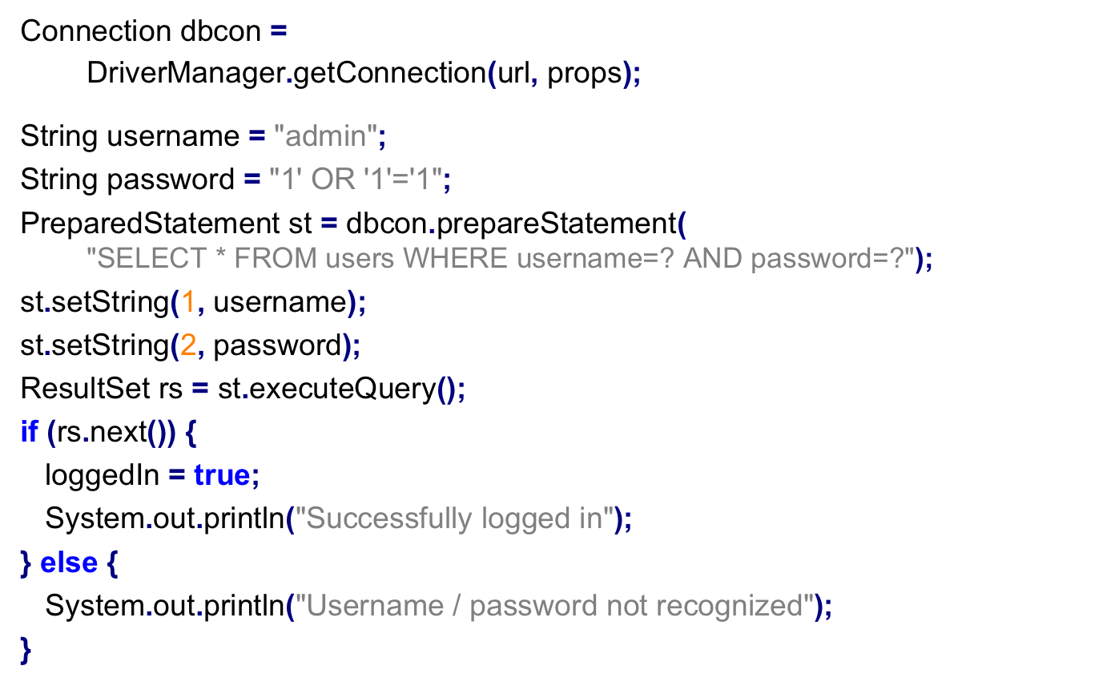
Fix SQL Injection

Slide 81
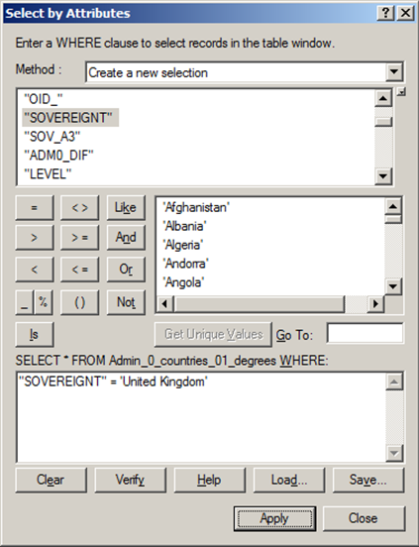
SQL Builder

Slide 82

Announcements
HW5 due date is on Friday (Mar 26 @ 8pm) – Project Phase 1
Mar 24 Self-care day
https://db.cs.pitt.edu/courses/cs1555/21-2/assign.html
Project Team Formation: 3-member Team
Deadline: Mar. 5 TODAY
Email to cs1555-staff@cs.pitt.edu
CC all team members
Listed on the email
You can also select a nickname for your team
Notes:
Costas’ Section II

